Slide 1
Partner Networking Call
Fall 2024
AGENDA
VA Updates – Ryan Weller
Alliance News – Aparna
WHV News - Torie
Benefits of HVP – Rev. Ed Tello
Community Connections – Dee Licona
Veteran’s Day Event Highlight – Corey Stepeck
Q&A to follow today’s agenda

Slide 2
The National Alliance for Care at Home

Slide 3
WHV for Non-Hospice Care at Home Providers
Interest Survey
Know a home care, home health, or other care at home provider who might be interested in joining WHV?
Encourage them to contact us at veterans@nhpco.org!

Slide 4
WHV Staff Transition
Continue to direct all inquiries to veterans@nhpco.org

Slide 5
WHV Top 10 Features

Slide 6
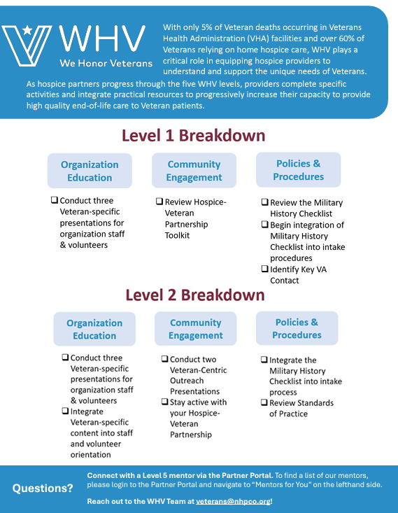
WHV Level Overview One-Pager

Slide 7
WHV Office Hours
Schedule through the end of 2024
Final WHV Office Hours for 2024
Thursday, December 12 from 3-3:30pm ET
Register to attend!
Office Hours previously scheduled for 11/21, 12/3, and 12/19 have been cancelled due to the holidays.
Have a question and can’t attend? Email veterans@nhpco.org

Slide 8
2024 Webinars & Resources
WHV & Opus Peace: Caregiver Distress
Updated Veteran Pinning Ceremony Guide
Identifying Clinically Meaningful Moral Injury
Dementia Series Part 1 & Part 2
Guide for Caring for Veterans of Foreign Militaries at EOL
WHV & Opus Peace: Bereavement Support
Community Nursing Home Initiative
Addressing Trauma and its Impacts
Caring for Veterans in their Final Hours
Ceremonies to Honor and Remember
Identifying and Addressing Source of Suffering
Overview for Frontline Staff
& Partner Networking Calls, Office Hours, and Newsletters

Slide 9
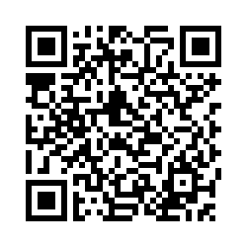
2024 WHV Partner Annual Survey
Scan here!

